Slide 1
COVID-19 Mechanical Ventilator titration & weaning protocol
Bonk
Lotano
Patel

Slide 2
Useful Tips
THE PURPOSE OF THIS PROTOCOL
Initiated by an ordering provider
Will provide guidance
Titrate rate, PEEP, tidal volume (Vt), and FIO2.

Slide 3
Policy
The ordering provider will determine that the patient is appropriate for the PEEP titration protocol based on the diagnosis of ARDS as defined by:
1. PaO2/ FiO2 < 300 or SpO2/FiO2 < 315 (1,2)
2. Diffuse interstitial infiltrates
3. No clinical evidence of left atrial hypertension (volume overload, heart failure)

Slide 4
FIO2 Wean Protocol
Use pulse oximetry (SpO2) for FiO2 weaning.
Within 30 minutes of intubation, if oxygen saturation is stable, wean FiO2 by .1 to .2 every 15-30 minutes with goal SpO2 is > 92-96%.
Initial blood gas should be sent, but Fi02 weaning does not need to be delayed if there is a good pulse oximetry signal.

Slide 5
Adjust Vt to a maximum of 6 ml/kg ideal body weight
The desired Vt will be calculated using the predicted body weight formula.
OR
by referencing the Ideal Body Weight (IBW) and tidal volume (Vt) nomogram
nomogram
• Males = 50 + 2.3 [height (inches) - 60]
• Females = 45.5 + 2.3 [height (inches) – 60]

Slide 6
Wean PEEP based on the table
Adjust the PEEP per FiO2 needed based on the PEEP Table to maintain the SpO2 within 92-96%
After changes have been completed, check the plateau pressure (Pplat), after a minimum of 2 minutes
If the Pplat is >30 cm H2O and driving pressure (Pplat minus PEEP) is >15 cm H2O, decrease Vt by 1ml/kg increments until target Pplat and or driving pressure is met (Goal pH > 7.2).
(Fio2 to be reduced first followed by PEEP)
Contact the critical care physician if breath stacking or dys-synchrony occurs.
Simplified PEEP table

Slide 7
Procedure for Spontaneous Parameters
Eligible Patients: PEEP of < or = 10 and FiO2 of < or = 0.4
Patients meeting criteria should be placed on a daily spontaneous breathing trial (SBT) after undergoing sedation interruption.
Those passing SBT after 30 minutes should proceed to extubation.
Patients not passing SBT should be placed on a spontaneous wean protocol utilizing Volume Support (Servo) or Pressure Support (Servo or GE) modes of mechanical ventilation.
Rapid Shallow breathing Index (RSBI)= RR/Vt
Target <105
RR=respiratory rate
Vt=Tidal volume

Slide 8
Volume Support Parameters
Vt is continuously monitored, and pressure adjusted to maintain target Vt
Allows for continuous weaning, target RSBI decreased PPE use and decreased exposure for providers
Set target Vt (4-6 cc/kg).
Set PEEP, FiO2
Consider extubation when ΔP (Peak pressure – PEEP) <8

Slide 9
Pressure support (PS) ventilation parameters
Set PS level above PEEP +5 cm H2O to target TV 4-6 cc/kg
Target RR <30 and comfortable
Titrate PSV down to maintain RSBI<100
RT must be instructed to manually titrate PSV down
Consider extubation when PSV<8

Slide 10
Extubation
Assess for cuff leak on Assist control ventilation
Consider course of IV steroids independent of cuff leak if intubated for > 10 days
Methylprednisolone 40 mg q12hr for 4 doses
< 110 mL – Do not extubate
Consider course of IV steroids if not already given
If failed twice, consider tracheostomy
≥ 110 mL – Proceed with extubation
Consider cough suppressant
Lidocaine through ETT
Small dose opioid
Dexmedetomidine

Slide 11
Extubation
If frequent, thin endotracheal secretions, the following can be considered:
Glycopyrrolate 10 mcg/kg q8hr
Chlorpheniramine 4 mg q6hr
Diuresis
Prepare drape, plastic bag (for ETT), and supplemental oxygen for extubation

Slide 12
Extubation
Non-invasive Support Post-extubation
HFNC offers multiple advantages over conventional nasal cannula including
decreased anatomic dead space
CO2 washout
improved mucociliary function
modest PEEP (0.4-0.8 per 10 L/min)

Slide 13
Non-invasive Support Post-extubation
Consideration for extubation to HFNC
Consideration for extubation to NIV
RSBI 80-105
Frequent endotracheal suctioning
Chronic hypoxic respiratory failure
BMI > 30
Age > 65
Chronic heart failure
Hypercarbic respiratory failure
> 1 failed weaning trial

Slide 14
Important P/F to S/F conversions
S/F = 64 +( 0.84 x P/F)
Mild ARDS | <300mmHg | <315
Moderate ARDS | <200mmHg | <235
Severe | <100mmHg | <148
Proning | <150mmHg | <190
Paralytic | <120mmHg | <165

Slide 15
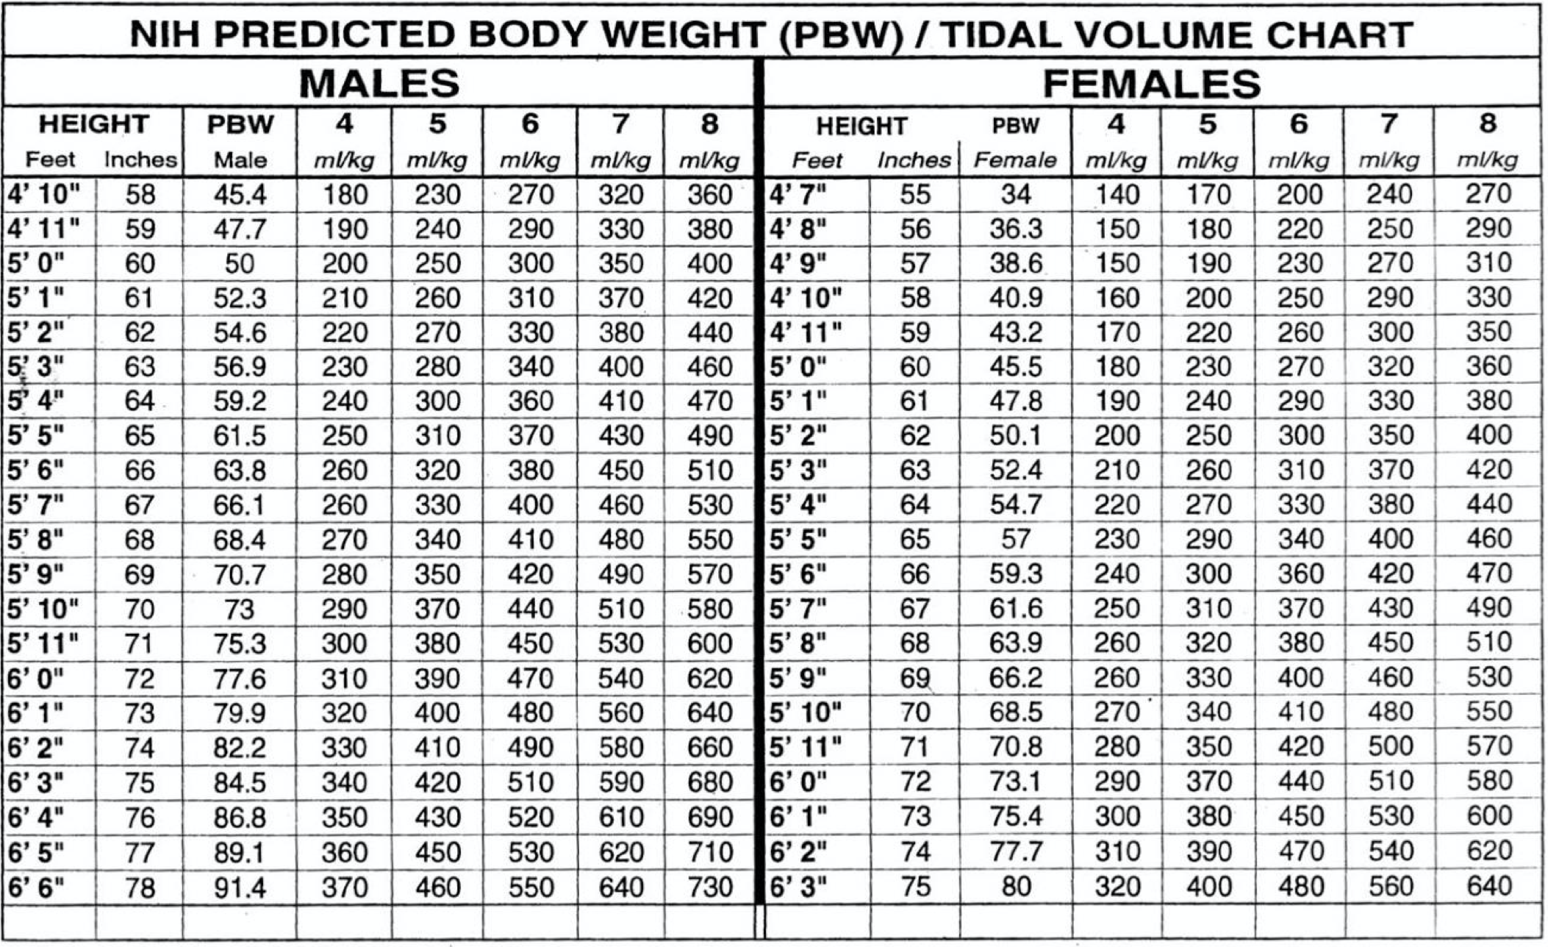

Slide 16
Questions

